Slide 1
Computer Organization & Design 实验与课程设计
Computer Organization & Design
Lab 9
Multi-cycle IP core integrated CPU
--build multi-cycle CPU debugging、test and application environment
Asso. Prof. Shi Qingsong
College of Computer Science and Technology, Zhejiang University
zjsqs@zju.edu.cn

Slide 2
Course Outline
Environment
Task
Principles
Implementation
Notes:
Rudimentary logic functions=基本的逻辑函数

Slide 3
Course Outline
Environment
Task
Principles
Implementation
Notes:
Rudimentary logic functions=基本的逻辑函数

Slide 4
Task
1. Build testing environment for CPU multicycle implementation
Rebuild Exp03 top module using structural description
Substitute CPU core using multicycle implementation
2. Substitute CPU core using datapath core and controller core
reuse modules of Exp03 except CPU

Slide 5
Course Outline
Environment
Task
Principal
Implementation

Slide 6
CPU organization
Digital circuit
General circuits that controls logical event with logical gates --Hardware
Computer organization
Special circuits that processes logical action with instructions -Software
Data input
Control unit
Control signals
Datapath
Data output
Status input
Status signals
Control output

Slide 7
Computer Organization
Decomposability of computer systems
Software
Control unit
Path: multiplexors
ALU
Registers
……
CPU
Computer System
Datapath
Hardware
Memory
Input: PS2
SW、BTN
I/O interface
Bidirectional: Storage
Output: VGA
7-Seg、LED

Slide 8
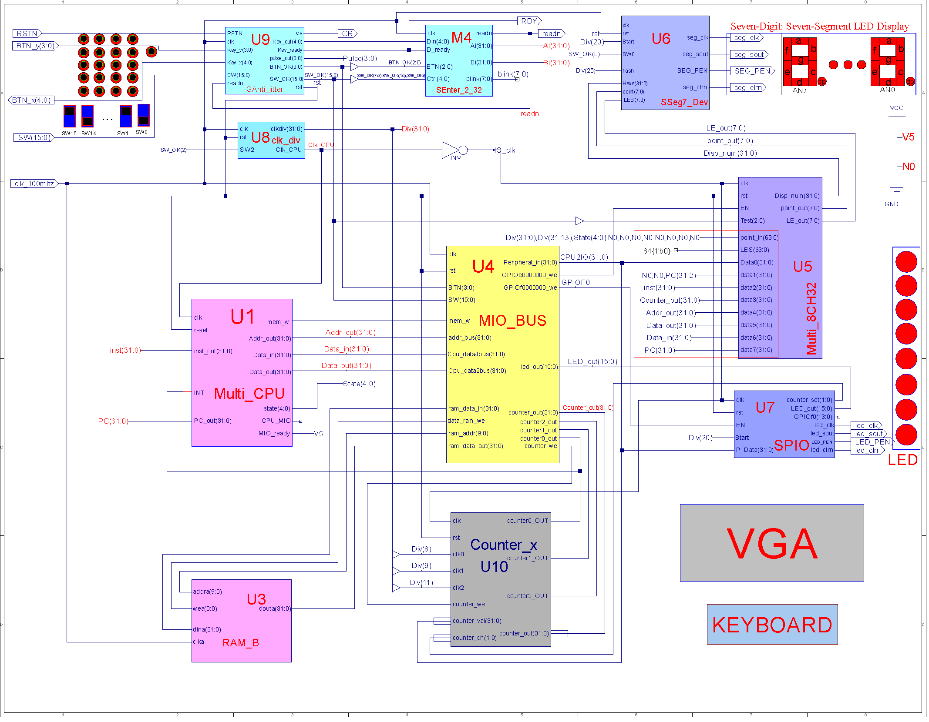
多周期处理器测试框架或SOC
Different from simple implementation
无ROM

Slide 9
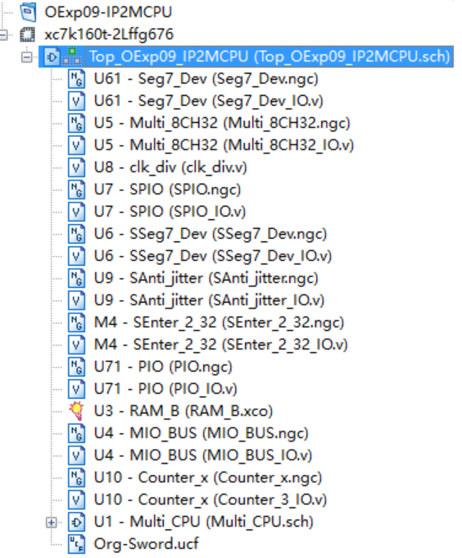
9 modules
Use 9 modules to build SOC test framework
U1： MCPU -Muliti-CPU
U2： ROM -ROM_D
U3： RAM -RAM_B
U4： Bus(含外设3~4) -MIO_BUS
U5： 7-seg display interface -Multi_8CH32
U6： 7-seg display -Seg7_Dev
U7： GPIO and LED -PIO
U8： clock -clk_div
U9： Anti-jitter -Anti_jitter
U10：Counter -Counter_x
以上除U1外与单周期共享

Slide 10
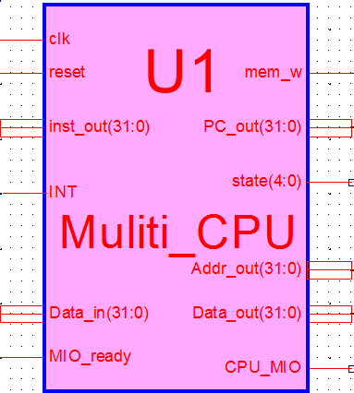
U1-CPU module：Multi-CPU
MIPS ISA
RISC
Three instruction formats
SOC test module
Consists of two IP cores: datapath and controller
Can be integrated directly with 2 IP cores
Or first use CPU IP core
Then use 2 IP cores after debugging
This lab can use IP Core- U1
Core module: Multi_CPU.ngc
interface：Multi_CPU.v
symbol：Multi_SCPU.sym

Slide 11
CPU core interface-Multi_CPU.v
module Muliti_CPU ( input wire clk,
input wire reset,
input wire MIO_ready, // be used：=1
output wire[31:0]PC_out, //Test
output[31:0] inst_out, //TEST
output wire mem_w, //存储器读写控制
output wire[31:0]Addr_out,//数据空间访问地址
output wire[31:0]Data_out//数据输出总线
input wire [31:0]Data_in, //数据输入总线
output wire CPU_MIO, // Be used input wire INT //中断
output[4:0]state //Test
);
endmodule
注意与单周期区别

Slide 12
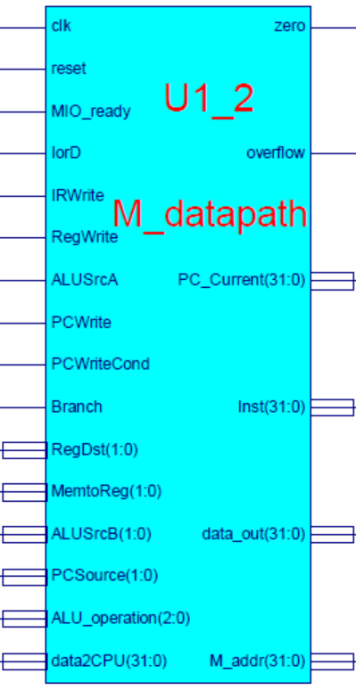
CPU unit 1-- datapath：M_datapath
MUX选择更多输入以兼容扩展
This lab use IP soft core- M_datapath
Core module: M_atapath.ngc
interface：M_datapath.v
symbol：M_datapath.sym
Important signals:
Inst：output of instruction register
PC_Current：current PC(PC+4)
M_addr：memory address
Branch(beq in textbook)：
=1：beq
=0：bne
PCWriteCond：Branch instruction

Slide 13
M_datapath.v
module M_datapath(input clk,
input reset,
input MIO_ready, //=1
input IorD,
input IRWrite,
input[1:0] RegDst, //预留到2位
input RegWrite,
input[1:0]MemtoReg, //预留到2位
input ALUSrcA,
input[1:0]ALUSrcB,
input[1:0]PCSource, //4选1控制
input PCWrite,
input PCWriteCond,
input Branch,
input[2:0]ALU_operation,
output[31:0]PC_Current,
input[31:0]data2CPU,
output[31:0]Inst,
output[31:0]data_out,
output[31:0]M_addr,
output zero,
output overflow
);
endmodule

Slide 14
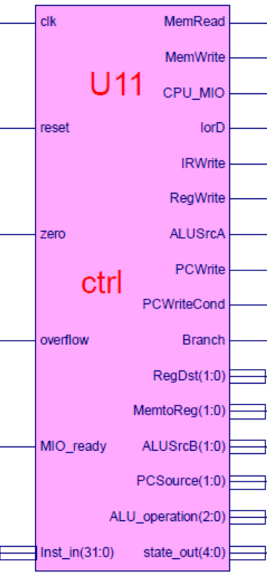
CPU unit 2-- controller：ctrl
This lab use IP soft core- ctrl
Core module: ctrl.ngc
Interface file：ctrl.v
symbol：ctrl.sym
Important signals:
MIO_ready：I/O is ready
=0 CPU wait
=1 CPU execute
Always be 1 in this lab
Inst_in：instruction input，coming from IR output
State_out：state codes，for test

Slide 15
Controller interface- ctrl.v
module ctrl(input clk,
input reset,
input [31:0] Inst_in,
input zero,
input overflow,
input MIO_ready,
output reg MemRead,
output reg MemWrite,
output reg[2:0]ALU_operation,
output [4:0]state_out,
output reg CPU_MIO,
output reg IorD,
output reg IRWrite,
output reg [1:0]RegDst,
output reg RegWrite,
output reg [1:0]MemtoReg,
output reg ALUSrcA,
output reg [1:0]ALUSrcB,
output reg [1:0]PCSource,
output reg PCWrite,
output reg PCWriteCond,
output reg Branch
);
endmodule

Slide 16
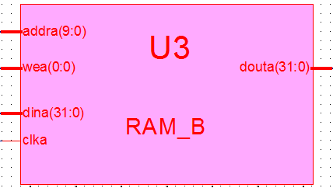
U3-Instructions storage：RAM_B
用Distributed Memory Generator没有clk信号
请编辑删除clka引脚。SP3平台用不用
RAM_B
Combine ROM and RAM of Lab3
Instruction and data share the same RAM
FPGA internal memory
Block Memory Generator or Distributed Memory Generator
Same Capacity with RAM_B of lab 3
1024×32bit
symbol：RAM_B.sym
Automatically generated one needs to be adjusted
In this lab, IP core should be generated again
RAM initialization file：mem.coe
Instructions and data are in the same memory
Core module: RAM_B.xco
Automated connected after generated，empty file is not needed

Slide 17
RAM_B is called in the same way as Lab3
ROM interface
RAM_B U3 ( .clka(clk_m), //存储器时钟，与CPU反向
.addra(ram_addr[9:0]), // RAM地址指针,来自MIO_BUS
.douta(ram_data_out) // RAM输出,代码或数据
);
Graphical symbol
RAM_B.sym
Empty file is not required
红色与单周期不同均通过MIO_BUS

Slide 18
U3-memory initialization file：mem.coe
memory_initialization_radix=16;
memory_initialization_vector=
3c03f000, 2014003f, 3c088000, 00632020, 20020001, 00000827, 00205020, 20070003, 00e73827, 20067fff,
00008820, 200502ab, ac650000, 20120002, ac600004, 8c650000, 00a52820, 00a52820, ac650000, ac660004,
3c0dffff, 8c650000, 00a52820, 00a52820, ac650000, 8c650000, 00a85824, 21ad0001, 11680015, 8c650000,
20120018, 00b25824, 11600005, 1172000a, 20120008, 1172000b, ac890000, 08000015, 11410001, 0800002a,
00005027, 014a5020, ac8a0000, 08000015, 8e2902a0, ac890000, 08000015, 8e290260, ac890000, 08000015,
3c0dffff, 014a5020, 01425025, 22310004, 02348824, 21290001, 11210001, 0800003b, 21290005, 8c650000,
00a55820, 016b5820, ac6b0000, ac660004, 8c650000, 00a85824, 1168fffd, 0800001d, 00000000, 00000000,
00000000, 00000000, 00000000, 00000000, 00000000, 00000000, 00000000, 00000000, 00000000, 00000000,
………………
………………
f0000000, 000002AB, 80000000, 0000003F, 00000001, FFFF0000, 0000FFFF, 80000000, 00000000, 11111111, 22222222, 33333333, 44444444, 55555555, 66666666, 77777777, 88888888, 99999999, aaaaaaaa, bbbbbbbb, cccccccc, dddddddd, eeeeeeee, ffffffff, 557EF7E0, D7BDFBD9, D7DBFDB9, DFCFFCFB, DFCFBFFF, F7F3DFFF, FFFFDF3D, FFFF9DB9, FFFFBCFB, DFCFFCFB, DFCFBFFF, D7DB9FFF, D7DBFDB9, D7BDFBD9, FFFF07E0, 007E0FFF,
03bdf020, 03def820, 08002300;
code：address start from 00000000
data：start address should be assigned

Slide 19
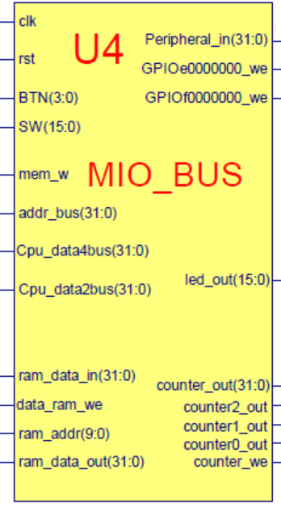
U4-bus interface：MIO_BUS
MIO_BUS
Module for CPU to exchange data with external
This lab combine all data exchange circuit into one module
simple，but not standard，hard for extension
Will use standard bus in follow-up courses
Wishbone bus
Basic function
Data storage、interface for Seg7、SW、BTN and LED
This lab use IP soft core -- U4
Core file: MIO_BUS.ngc
Interface file (empty)：MIO_BUS.v
Symbol file：MIO_BUS.sym
note：if increase RAM capacity, address decoder should be modified

Slide 20
IO interface empty file-MIO_BUS.v
module MIO_BUS( input wire clk, input wire rst,
input wire [3:0] BTN, input wire [15:0]SW,
input wire mem_w,
input wire [31:0] Cpu_data2bus, //data from CPU
input wire [31:0] addr_bus, //addr from CPU
input wire [31:0] ram_data_out,
input wire [15:0] led_out,
input wire [31:0] counter_out,
input wire counter0_out,
input wire counter1_out,
input wire counter2_out,
output wire [31:0] Cpu_data4bus, //write to CPU
output wire [31:0] ram_data_in, //from CPU write to Memory
output wire [9: 0] ram_addr, //Memory Address signals
output wire data_ram_we,
output wire GPIOf0000000_w, // GPIOffffff00_we
output wire GPIOe0000000_we, // GPIOfffffe00_we
output wire counter_we, //记数器
output wire [31:0] Peripheral_in //送外部设备总线
);
endmodule

Slide 21
Signals of MIO_BUS
MIO_BUS U4( clk_100HzM, //clock on board
rst, //reset，button BTN3
BTN [3:0] , //4 bits original button input
SW [15:0], //8 bits original switch input
mem_w, //memory read/write signal，from CPU
Cpu_data2bus [31:0] , //CPU data output bus
addr_bus [31:0] , //address bus，from CPU
ram_data_out [31:0] , //from RAM data output
led_out [7:0], //from LED output
counter_out [31:0] , //当前通道计数输出，来自计数器外设
counter0_out, //通道0计数结束输出，来自计数器外设
counter1_out, //通道1计数结束输出，来自计数器外设
counter2_out, //通道2计数结束输出，来自计数器外设
Cpu_data4bus [31:0] , //CPU写入数据总线，连接到 CPU
ram_data_in [31:0] , //RAM 写入数据总线，连接到RAM
ram_addr [9: 0] , //RAM访问地址，连接到RAM
data_ram_we, //RAM读写控制， 连接到RAM
GPIOf0000000_w, // 设备一LED写信号
GPIOe0000000_we, // 设备二7段写信号，连接到U5
counter_we, //记数器写信号，连接到U10
Peripheral_in [31:0] //外部设备写数据总线，连接所有写设备
);
endmodule

Slide 22
GPIO interface module
--same with lab 3

Slide 23
U7-GPIO device interface 1-- SPIO
GPIO output device
address=f0000000 - ffffffff0 (ffffff00-ffffffff0)
Read/write control signal：GPIOf0000000_we(GPIOffffff00_we)
{GPIOf0[21:0],LED,counter_set}
Function
LEDs and counter 控制器读写
可回读，检测状态
In this lab, we use soft IP core- U7
Core calling: SPIO.ngc
interface file：SPIO_IO.v
symbol：SPIO.sym
rst
Device GPIO
& LED
22位
GPIOf0
Peripheral_in
Counter_set
8-LED
GPIOf0000000_we
led_out
clk_io

Slide 24
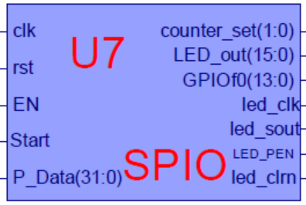
IP core call empty module -PIO.v
module PIO(input clk, //io_clk，与CPU反向
input rst,
input EN, //来自U4
input [31:0] P_Data, //来自U4
input Start //串行输出启动
output [1:0] counter_set, //来自U7，后继用
output [15:0] led_out, //输出到LED,回读到U4
output [13:0] GPIOf0 //备用
output led_clk, //串行时钟
output led_sout, //串行LEDE值
output LED_PED, //LED使能
output led_clrn //LED清零
);
endmodule

Slide 25
U6-GPIO device 2: SSeg_Dev
7-seg display module
Connect to CPU through Multi_8CH32
address=E0000000 - EFFFFFFF (FFFFFE00-FFFFFEFF)
Function (refer to lab2)
Use soft IP core - U5
SSeg7_Dev.ngc
SSeg7_Dev.v
SSeg7_Dev.sym

Slide 26
U6-GPIO device 2： Seg7_Dev
SP3 is compatible with adurino
7-seg display module
Connect to CPU through Multi_8CH32
address=E0000000 - EFFFFFFF (FFFFFE00-FFFFFEFF)
Function (refer to lab2)
Use soft IP core - U5
SSeg7_Dev.ngc
SSeg7_Dev.v
SSeg7_Dev.sym

Slide 27
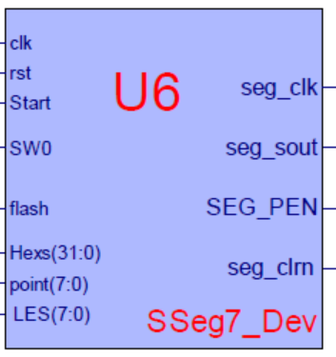
Interface file: SSeg7_Dev.v
module SSeg7_Dev(input wire [31:0] disp_num, //来自U5
input wire [1:0]SW, //来自U9
input wire flash_clk, //通用分频器
input wire [1:0] Scanning, //来自U8
input wire [3:0] pointing, //来自U5
input wire [3:0] blinking, //来自U5
output wire [3:0] AN,
output reg [7:0] SEGMENT //来自U5
);
endmodule

Slide 28
U5- Interface module Multi_8CH32
GPIO output interface module
address=E0000000 - EFFFFFFF (FFFFFE00-FFFFFEFF)
Read/write control signal：GPIOe0000000_we(GPIOfffffe00_we)
Function (refer to Exp02)
Data0 as the display interface
GPIOe0000000_we=1
CLK positive edge
Data1-data7: debug signal
Use soft IP core U6
核调用模块Multi_8CH32.ngc
核接口信号模块(空文档)： Multi_8CH32_IO.v
核模块符号文档：Multi_8CH32.sym
rst
Test_data0
GPIO
Multi_8CH32
Seg7 Device
…
…
Test_data7
Peripheral_in
GPIOe0000000_we
disp_num
Peripheral_in
clk_io

Slide 29
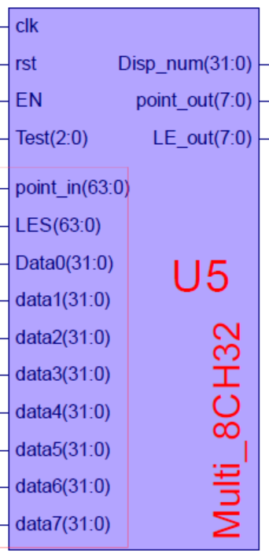
Interface file -Multi_8CH32_IO.v
module Multi_8CH32 ( input clk, //io_clk，同步CPU
input rst,
input EN, //=1, 通道0显示
input[63:0]point_in, //针对8个显示通道各8个小数点
input[63:0]blink_in, //针对8个通道各8位闪烁控制
input [2:0] Test, //通道选择SW[7:5]
input [31:0] Data0, //通道0
input [31:0] data0, //通道1
input [31:0] data1, //通道2
input [31:0] data2, //通道3
input [31:0] data3, //通道4
input [31:0] data4, //通道5
input [31:0] data5, //通道6
input [31:0] data6, //通道7
output reg[3:0] point_out, //小数点输出
output reg[3:0] blink_out, //闪烁控制输出
output [31:0] disp_num //接入7段显示器
);
endmodule

Slide 30
Signals of Multi_8CH32
Multi_8CH32 U5( .clk(clk_io), .rst(rst),
. EN(GPIOe0000000_we), //来自U4
. point_in(point_in), //外部输入
.blink_in(blink_in), //外部输入
.Test(SW_OK[7:5]), //来自U9
.Data0(Peripheral_in), //来自U4
.data1({2‘b00,PC_out[31:2]}), //来自U1
.data2(counter_out), //来自U10
.data3(Inst), //Inst，来自CPU
.data4(addr_bus), //来自CPU
.data5(Cpu_data2bus), //来自CPU
.data6(Cpu_data4bus), //来自CPU
.data7(PC_out), //来自CPU;
.point_out(point_out), //输出到U6
.blink_out(blink_out), //输出到U6
.disp_num(disp_num) //输出到U6
);

Slide 31
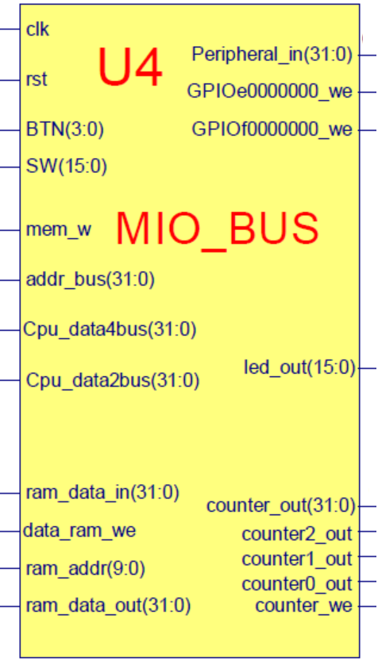
GPIO device interface 3,4: Device_GPIO_SW_BTN
8-bits Switch and 4-bits Button input
address= f0000000-ffffffff0，A[2]=0
These two devices are included in U4，MIO_BUS
Relation with CPU data bus（when addre_bus=f0000000）
Cpu_data4bus = {counter0_out, counter1_out, counter2_out, 1'h000, BTN,SW};
mem_w=0
addre_bus=f0000000
CPU
Led out
BTN
Cpu_data4bus
SW
clk_io

Slide 32
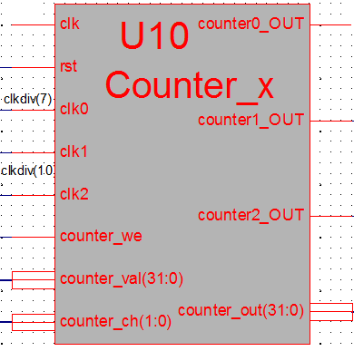
U10-peripheral device 5: Counter_x.v
General counter，
address=F0000004 – FFFFFFF4 (FFFFFF04-FFFFFFF4)
r/w control：counter_we
Function
3 paths independent counter
Output for choose path or initialization
counter_set=00、01、10 for path0、1、2
counter_set=11对应计数通道工作设置
Use soft IP core- U10
核调用模块Counter_x.ngc
核接口信号模块(空文档)：Counter_x.v
核模块符号文档：Counter_x.sym

Slide 33
Interface file -Counter_x.v
module Counter_x(input clk, //io_clk
input rst,
input clk0, //clk_div[7]，来自U8
input clk1, // clk_div[10]，来自U8
input clk2, //clk_div[10]，来自U8
input counter_we, //计数器写控制，来自U4
input [31:0] counter_val, //计数器输入数据，来自U4
input [1:0] counter_ch, //计数器通道控制，来自U7
output counter0_OUT, //输出到U4
output counter1_OUT, //输出到U4
output counter2_OUT, //输出到U4
output [31:0] counter_out //输出到U4
);
endmodule

Slide 34
SOC auxiliary modules
U8：clk_div
U9：anti-jitter
Refer to previous lab

Slide 35
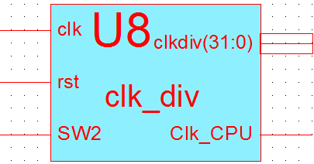
clk_div.v
module clk_div(input clk,
input rst,
input SW2,
output [31:0]clkdiv,
output Clk_CPU
);
endmodule

Slide 36
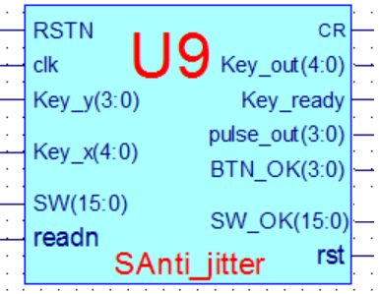
Anti_jitter.v
module SAnti_jitter(input clk, //主板时钟
input RSTN
input readn //阵列式键盘读
input [3:0]Key_y, //阵列式键盘列输入
output reg[4:0] Key_x, //阵列式键盘行输出
output reg[4:0] Key_out,//阵列式键盘扫描码
output reg Key_ready, //阵列式键盘有效
input [15:0] SW, //开关输入
output reg [3:0] ] BTN_OK,//列按键输出
output reg [3:0] pulse, //列按键脉冲输出
output reg [15:0] SW_OK, //开关输出
output reg CR, //RSTN短按输出
output reg rst //复位， RSTN长按输出
);
endmodule

Slide 37
Multi_8CH32 signals
Multi_8CH32 U5( .clk(clk_io), .rst(rst),
. EN(GPIOe0000000_we), //来自U4
. point_in(point_in), //外部输入
.blink_in(LE_in), //外部输入
.Test(SW_OK[7:5]), //来自U9
.Data0(Peripheral_in), //来自U4
.data1({2‘b00,PC_out[31:2]}), //来自U1
.data2(counter_out), //来自U10
.data3(Inst), //Inst，来自CPU
.data4(addr_bus), //来自CPU
.data5(Cpu_data2bus), //来自CPU
.data6(Cpu_data4bus), //来自CPU
.data7(PC_out), //来自CPU;
.point_out(point_out), //输出到U6
.LE_out(blink_out), //输出到U6
.disp_num(disp_num) //输出到U6
);

Slide 38
Course Outline
Environment
Task
Principle
Implementation

Slide 39
Project：OExp09-IP2MCPU
Build CPU debugging、testing environment
Top implemented in HDL，call IP core modules
Module name：Top_OExp09_IP2MCPU.sch
Use SOC integration to implement testing framework
Reuse modules of lab 3 except SCPU
CPU (given IP core)：U1
RAM (ISE build IP core)：U3
BUS(given IP core)：U4
8-to-1 datapath(Multi_8CH32 of lab1)：U5
7-seg display(SSeg7_Dev IP of lab2)：U6
LED display(SPIO of lab2)：U7
通用分频模块(clk_div)：U8
开关去抖模块(IP core)：U9
Data input (IP core)：M4(not in use for the moment)
Decompose CPU into two IP cores
After SOC debugging, use two IP cores to build MCPU

Slide 40
Design
Build multicycle SOC testing environment
--new project OExp09-IP2MCPU

Slide 41
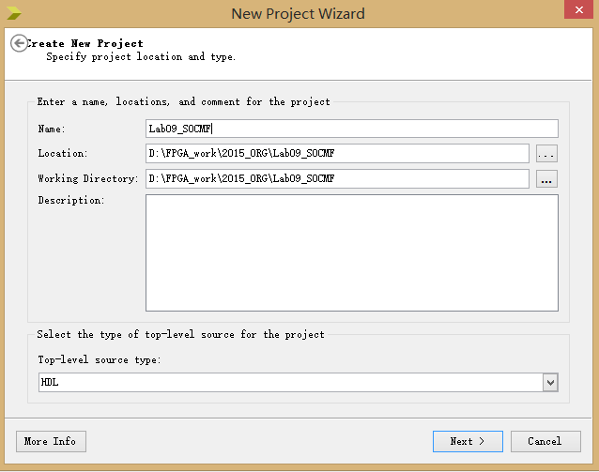
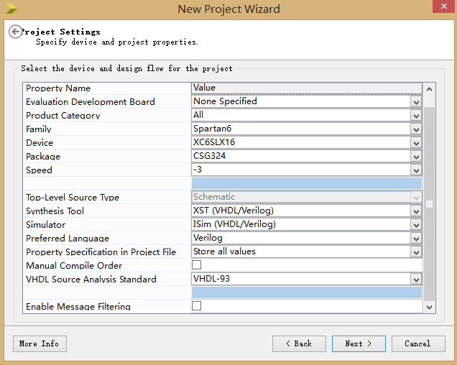
Build multicycle SOC environment
New SOC testing project in ISE
Reference project name：ORG-Exp09或OExp09_IP2MCPU
This project is shared for multicycle CPU design
Top-level Source type
HDL

Slide 42
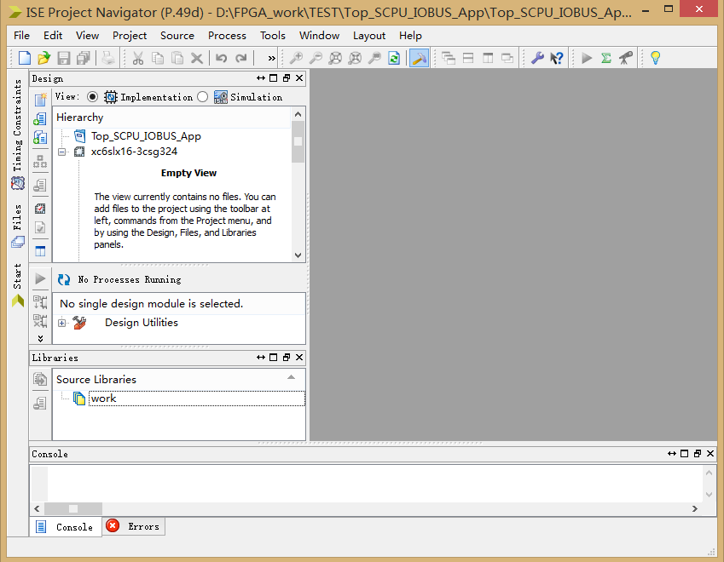
Project interface

Slide 43
This lab use HDL description, don’t need to copy module symbol files
Copy U1、U3~U10、multicycle controller、datapath soft core(.ngc) files to current project dir
--except your own implemented modules
--better use your own clk_div

Slide 44
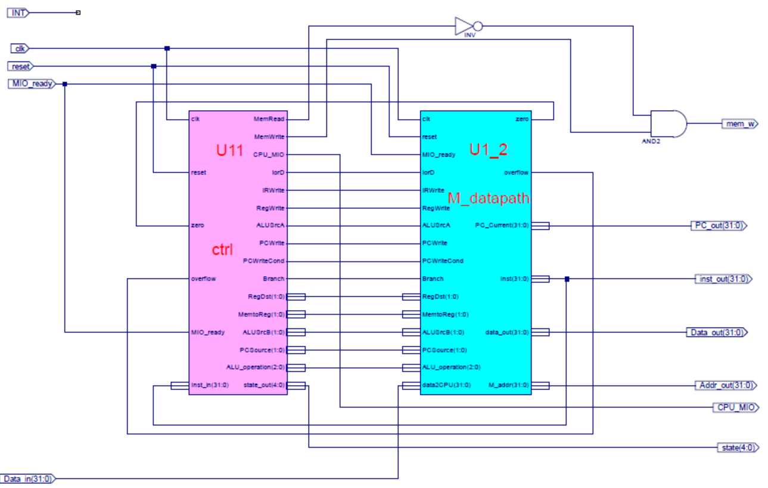
Design multicycle CPU module
Use HDL to call IP core and implement CPU
Suggested name：Multi_CPU.v或MCPU.v

Slide 45
CPU HDL description reference
module Muliti_CPU(input clk, //muliti_CPU
input reset,
input MIO_ready,
output[31:0] PC_out, //TEST
output[31:0] inst_out, //TEST
output mem_w,
output[31:0] Addr_out,
output[31:0] Data_out,
input [31:0] Data_in,
output CPU_MIO,
input INT,
output[4:0]state //Test
);
endmodule
………… variable statement：attention signal width for all wire statements
…………initialization、temp signal，bus transition etc
………… module call：2 calls

Slide 46
Key signals and module calls
……
assign mem_w=MemWrite&&(~MemRead);
assign PC_out=PC_Current;
ctrl x_ctrl(.clk(clk),
.reset(reset),
.Inst_in(inst_out),
……
.PCWrite(PCWrite),
.PCWriteCond(PCWriteCond),
.Branch(Branch)
);
M_datapath x_datapath(.clk(clk),
.reset(reset),
.MIO_ready(MIO_ready),
……
.M_addr(Addr_out),
.zero(zero),
.overflow(overflow)
);

Slide 47
SOC framework top description
--HDL，call IP core module

Slide 48
According to the following schematic to write HDL code simple：just interface definition and module call

Slide 49
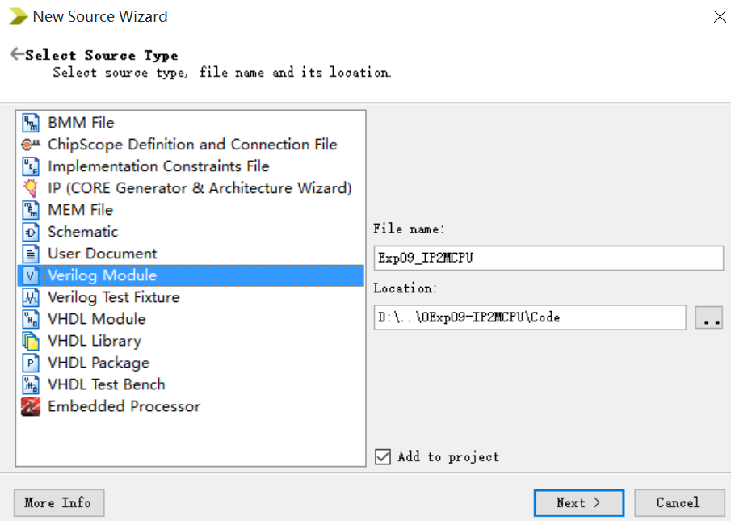
Build top module
New top module
Default dir is project dir “Exp09_IP2MCPU”
Suggested to change as “Exp09_IP2CPU \Code”
note：put all codes into a separate directory for convenience ！
Note conflicts for the same name .sch and .v files
Write top code according to schematic fig
Use SOCMF.v as an example

Slide 50
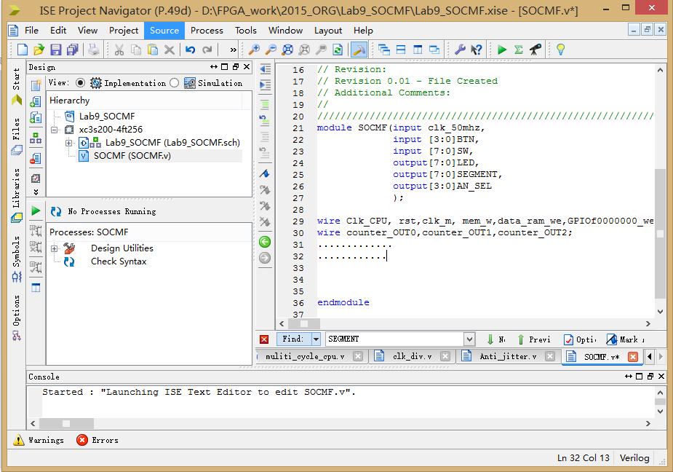
代码输入区

Slide 51
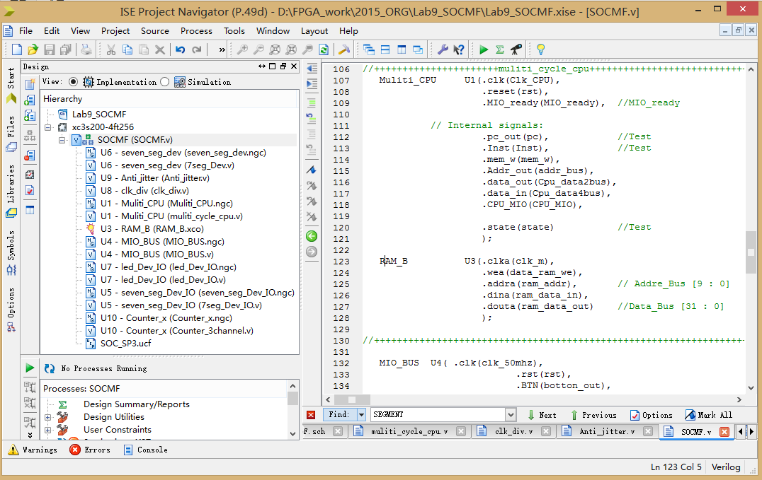
The second level
CPU核

Slide 52
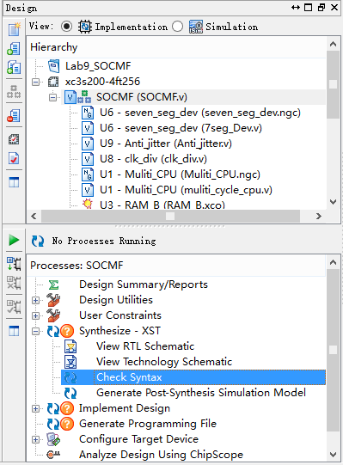
Syntax checking for top
Checking signal connection
Active Design window
Choose top：SOCMF.v
In the running window： choose Synthesze→Check Syntax
Note
It won’t check logic function
Only code syntax
Pay attention to bus connection
Real Connection
Name/rename

Slide 53
Module call and connection
method
Module_name call_number(port signal list)；
Port signal corresponds to:
Signals in the module
Refered use brancket：.signal in the module(input)
eg：.clk(clk_100mHz)
Relation of called modules
Put module Symbol in top module, the corresponding modules will be called directly
Connect the interface module and soft core module
Contains only the interface signal, there is no code inside.v
Synthesizer will connect the signals
Click “Add Source” to connect the corresponding empty module b

Slide 54
Top (SOC test environment) reference
module IP2CPU(input clk_50mhz,
input [3:0]BTN,
input [7:0]SW,
output[7:0]LED,
output[7:0]SEGMENT,
output[3:0]AN_SEL
);
Wire Clk_CPU, rst, clk_m, mem_w, data_ram_we, GPIOf0000000_we, GPIOe0000000_we, counter_we;
wire counter_OUT0, counter_OUT1, counter_OUT2;
wire [1:0]Counter_set;
wire MIO_ready;
wire CPU_MIO;
endmodule
………… variable statement：attention signal width for all wire statements
…………initialization、temp signal，bus transition etc
………… module calls ：9 modules

Slide 55


Signal transmission： initialization、temp signal when connecting modules，signal transformation、bus transformation
assign MIO_ready=~button_out[1]; //CPU永远不等待，或=1
assign SW2=SW_OK[2]; //信号传输
assign LED={led_out[7]|Clk_CPU,led_out[6:0]};//总线转换
assign clk_m=~clk_50mhz;
…………
assign clk_io=~Clk_CPU;
…………

Slide 56
Module calls
SAnti_jitter U9(clk, //主板时钟
RSTN
readn
Key_y, //阵列式键盘列输入
Key_x, //阵列式键盘行输出
Key_out, //阵列式键盘扫描码
……
rst //复位， RSTN长按输出
);
clk_div U8(clk_50mhz, // Clock divider-时钟分频器
rst,
SW2,
clkdiv,
Clk_CPU
);

Slide 57
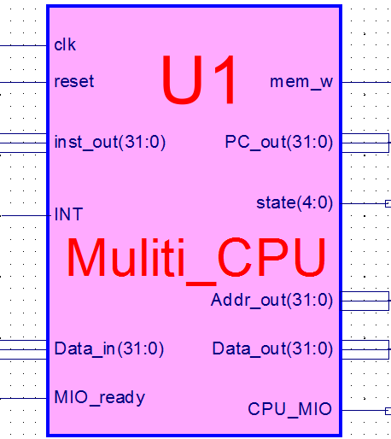
Module calls
SSeg7_Dev U6( .disp_num(disp_num),
. SW(SW_OK(1:0)),
……
……
.AN(digit_anode)
);
Muliti_CPU U1(.clk(Clk_CPU),
.reset(rst),
.MIO_ready(MIO_ready), //MIO_ready
……
……
.state(state) //Test
);
Notes:
(input wire [31:0] disp_num, //来自U5
input wire [1:0]SW, //来自U9
input wire flash_clk,

Slide 58
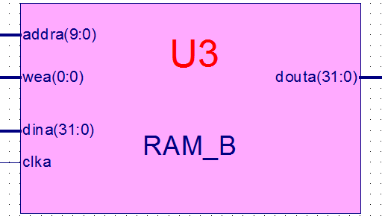
Module calls
RAM_B U3(.clka(clk_m),
.wea(data_ram_we),
.addra(ram_addr), // Addre_Bus [9 : 0]
.dina(ram_data_in),
.douta(ram_data_out) //Data_Bus [31 : 0]
);
MIO_BUS U4( .clk(clk_50mhz),
……
……
.Peripheral_in(Peripheral_in)
);

Slide 59
Module calls
led_Dev_IO U7( clk_io,
……
……
GPIOf0 );
seven_seg_Dev_IO U5( .clk(??),
.rst(rst),
.GPIOe0000000_we(??),
.Test(SW_OK[7:5]),
.disp_cpudata(??), //CPU data output
.Test_data1({2'b00,pc[31:2]}), //pc[31:2]
.Test_data2(counter_out), //counter
.Test_data3(??), //Inst
.Test_data4(??), //addr_bus
.Test_data5(??), //Cpu_data2bus;
.Test_data6(??), //Cpu_data4bus;
.Test_data6(??), //pc; .disp_num(??)
);

Slide 60
Module calls
Counter_x U10(.clk(clk_io),
.clk0(clkdiv[9]),
.clk1(clkdiv[10]),
.clk2(clkdiv[10]),
.counter_we(counter_we),
.counter_val(Peripheral_in),
.counter_ch(Counter_set),
.counter0_OUT(counter_OUT0),
.counter1_OUT(counter_OUT1),
.counter2_OUT(counter_OUT2),
.counter_out(counter_out)
);
endmodule

Slide 61
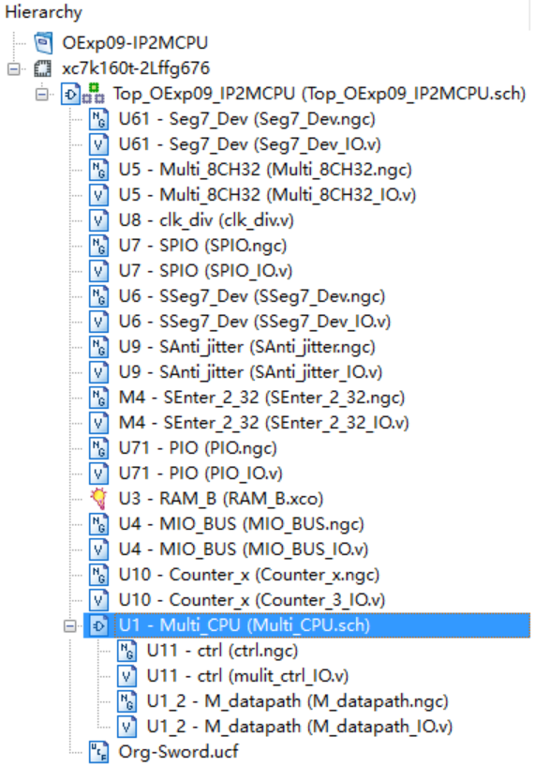
Finished module relations
Top use HDL description
Either HDL or schematic to describe CPU
IP core integrated CPU

Slide 62
SoC physical verification
-no test for this lab，just use DEMO to verify functions
-same as lab3, lab4

Slide 63
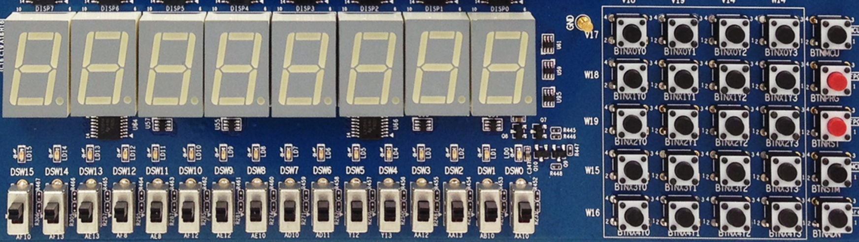
DEMO interface
X₀Y₀
X₀Y₁
X₀Y₂
X₀Y₃
MCU3
0
1
2
3
X₁Y₀
X₁Y₁
X₁Y₂
X₁Y₃
PRGO
SEG3
SEG2
SEG1
SEG0
SEG3
SEG2
SEG1
SEG0
4
5
6
7
X₂Y₀
X₂Y₁
X₂Y₂
X₂Y₃
RSTN
LED15 LED14 LED13 LED12 LED11 LED10 LED9 LED8 LED7 LED6 LED5 LED4 LED3 LED2 LED1 LED0
8
9
A
B
X₃Y₀
X₃Y₁
X₃Y₂
X₃Y₃
MCU1~2
C
D
E
F
W15 SW14 SW13 SW12 SW11 SW10 SW9 SW8 SW7 SW6 SW5 SW4 SW3 SW2 SW1 SW0
X₄Y₀
X₄Y₁
X₄Y₂
X₄Y₃
Ardunio
SW[7:5]=显示通道选择
SW[7:5]=000：CPU程序运行输出
SW[7:5]=001：测试PC字地址
SW[7:5]=010：测试指令字
SW[7:5]=011：测试计数器
SW[7:5]=100：测试RAM地址
SW[7:5]=101：测试CPU数据输出
SW[7:5]=110：测试CPU数据输入
SW[0]=文本图形选择
SW[1]=高低16位选择
没有使用
SW[2]=CPU单步时钟选择
SW[4:3]=00，点阵显示程序：跑马灯
SW[4:3]=00，点阵显示程序：矩形变幻
SW[4:3]=01，内存数据显示程序：0～F
SW[4:3]=10，当前寄存器+1显示

Slide 64
Download and test SoC
Simulation without IP core
Do simulation for your owned designed module(pass those that have been simulated in single-cycle labs)
No simulation for the given IP core
SOC physical verification
Download .bit file
test functions of SOC
Debugging if there is any error
qualitatively observe key signals of SOC
use mem.coe as test code and test data*

Slide 65
Switch test
Graphical function test
Text function test
开关 | 位置 | 功能
SW[1:0] | X0 | 七段码图形显示
SW[2] | 0 | CPU全速时钟
SW[4:3] SW[4:3] | 00 11 | 7段码从上至下亮点循环右移 7段码矩形从下到大循环显示
SW[7:5] | 000 | 作为外设使用（E0000000/FFFFFE00）
开关 | 位置 | 功能
SW[1:0] | 01 11 | 七段码文本显示（低16位） 七段码文本显示（高16位）
SW[2] | 0 | CPU全速时钟
SW[4:3] SW[4:3] | 01 10 | 7段码显示RAM数字 7段码显示累加
SW[7:5] | 000 | 作为外设使用（E0000000/FFFFFE00）

Slide 66
Qualitatively observation
SOC signal testing
CPU running in one step
Switch test
开关 | 位置 | 功能
SW[1:0] | 01 | 七段码文本显示（低16位）
SW[1:0] | 11 | 七段码文本显示（高16位）
SW[2] | 0 | CPU全速时钟
SW[7:5] | 010 | Counter值输出
SW[7:5] | 100 | CPU数据存储地址addr_bus（ALU）
SW[7:5] | 101 | CPU数据输出Cpu_data2bus (寄存器B)
SW[7:5] | 110 | CPU数据输入Cpu_data4bus(RAM输出)

Slide 67
Qualitatively observation
SOC signal testing
CPU running step by step
Switch testing
Design test program to substitute DEMO*
开关 | 位置 | 功能
SW[1:0] | 01 | 七段码文本显示（低16位）
SW[1:0] | 11 | 七段码文本显示（高16位）
SW[2] | 1 | CPU单步时钟
SW[7:5] | 001 | CPU指令字地址PC_out[31:2]
SW[7:5] | 011 | ROM指令输出Inst_in
SW[7:5] | 100 | CPU数据存储地址addr_bus(ALU输出)
SW[7:5] | 101 | CPU数据输出Cpu_data2bus(寄存器B)
SW[7:5] | 110 | CPU数据输入Cpu_data4bus(RAM输出)
SW[7:5] | 111 | CPU指令字节地址PC_out

Slide 68
END

